Slide 1

PDAS CA1
LIM JUN YI
DAAA/FT/1B/03
P2308924

Slide 2
Data Analysis Question
How does climate change affect the weather in Singapore?

Slide 3

Reason why I pick the problem statement
Climate change is becoming more serious as the years go by and it’s impacting the world. (Icebergs melting, low-lying countries starting to flood, etc).
Temperature all over the globe are rising.
Additionally, global warming is becoming a serious issue to all countries.

Slide 4
Insights

Slide 5
Data Analysis Process
Finding the right dataset
Exploratory Data Analysis (EDA)
Graph/Chart on the data set
- Search on data.gov.sg on any datasets that are linked with the weather in Singapore
- Search on other sites if needed
- Find out what the data contains, data types, shape of the data
- Find more information on the data
- Plotting a graph/chart that is suitable for that dataset
- Visualize and analyse the plot

Slide 6
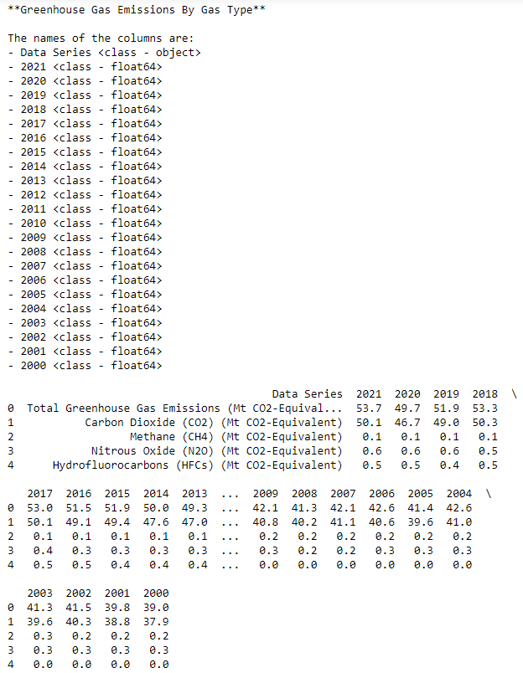
EDA on Greenhouse Gas Emissions By Gas Type
- This dataset contains the greenhouse gas emissions by all gas type in Singapore
- It includes the different greenhouse gases that are emitted throughout the years from 2000 to 2021 in Singapore
I’m using the emissions of greenhouse gases as a gauge on how serious climate change is on the weather on Singapore. If the emissions are high for that year, I will assume that the climate change is more serious and thus, global warming has a larger effect on that year.
Columns:
Data Series = Greenhouse gas emitted (string)
Rest of the columns (Years) = Amount of gas emitted

Slide 7
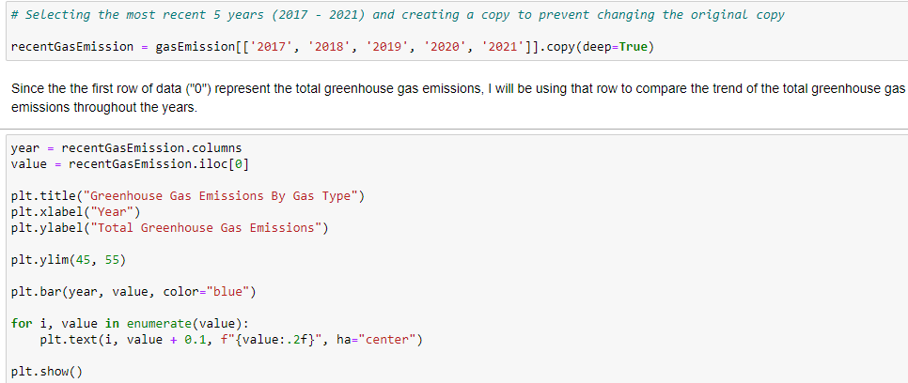
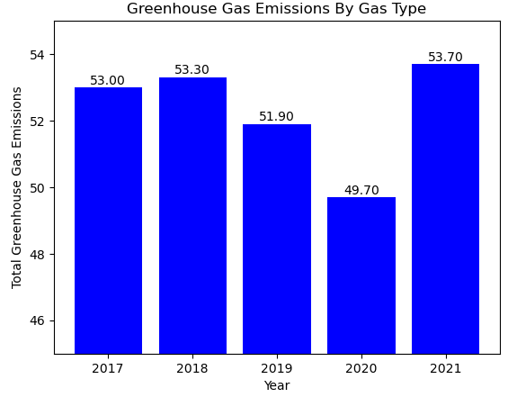
Bar Chart on Greenhouse Gas Emissions By Gas Type
Reason → I chose bar chart for this data as it is useful to compare different categorical variables (Years) based on the total greenhouse gas emissions. It provides an easier visibility of the values throughout the year.
I only used the most recent 5 years available in the dataset as they are the latest data and provide a more present analysis on what climate change is in Singapore.
This bar chart suggests that in these 5 years, 2020 contains the least amount of total greenhouse gas emissions, 2021 contains the most amount of total greenhouse gas emissions. Thus, I will be finding out the different weather aspects in Singapore for both these years to see what impact climate change does on the weather in Singapore.

Slide 8
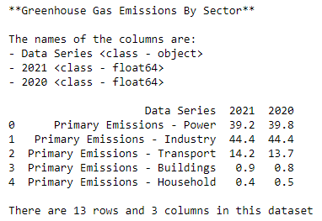
EDA on Greenhouse Gas Emissions By Sector
- This dataset contains the greenhouse gas emissions by sector in Singapore
- It includes the percentages of the different greenhouse gases in the years from 2000 to 2021 in Singapore
Columns:
Data Series = Greenhouse gas emitted (string)
Rest of the columns (Years) = Percentages of what the greenhouse gas emitted out of the total

Slide 9
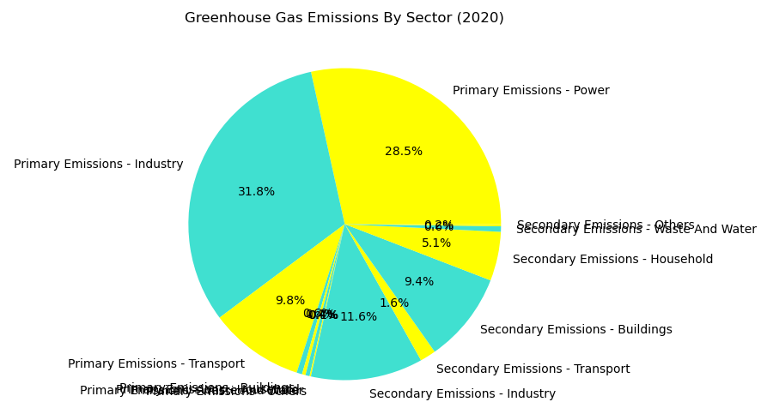

Pie Chart on Greenhouse Gas Emissions By Sector
Reason → I chose pie chart for this data as it contains different percentages of how much the different greenhouse gases holds in the total emissions.
This bar chart suggests the top 3 highest emitted greenhouse gases are from the industry, power, and transport. This implies that these 3 sectors are producing the most greenhouse gases and are contributing majorly to climate change (global warming)
Thus, if the government would want to reduce the emissions, they can focus more on these areas.

Slide 10
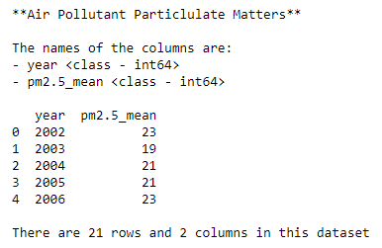
EDA on Air Pollutant - Particulate Matter PM 2.5
- This dataset contains the Air Pollutant - Particulate Matter PM 2.5
PM 2.5 → Particle pollution from fine particulates, and it is a concern when levels in air are unhealthy. Breathing in unhealthy levels of PM2.5 can increase the risk of health problems like heart disease, asthma, and low birth weight. Unhealthy levels can also reduce visibility and cause the air to appear hazy.
Columns:
Pm2.5_mean = mean of the number of particle pollution
Year = years that have measured PM 2.5

Slide 11
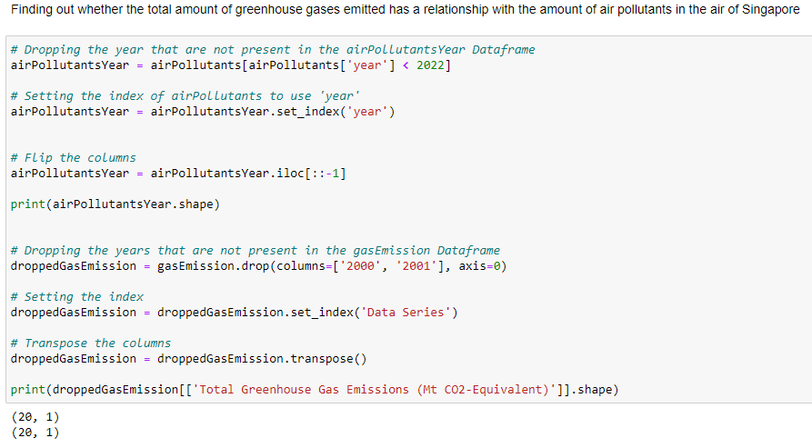
Data Manipulation on Air Pollutant - Particulate Matter PM 2.5
In order to find out the relationship between air pollutants and greenhouse gas emissions, I will be using a scatter plot to allow better analysis.
However, before plotting the scatter plot, I will have to manipulate data on both dataset, as they will have to be in the same shape to be able to be plotted on the scatter plot.
Transpose() → changing the columns into rows

Slide 12
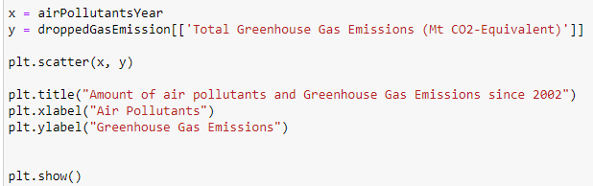
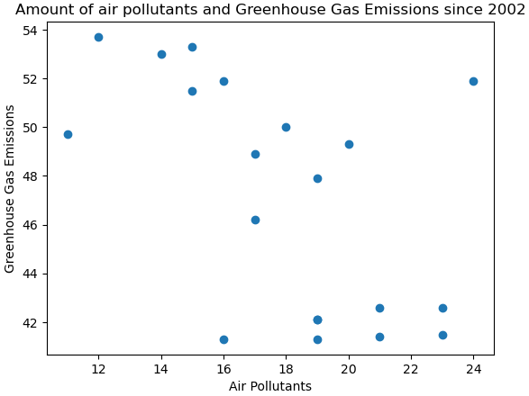
Scatter Plot between 2 variables
Reason → I chose Scatter Plot as it’s the most useful when I’m trying to find a relationship between 2 variables.
As we can observe from the scatter plot, the data points are scattered all over the plot. This implies that there is close to no linear relationship between the 2 variables.
To conclude, the greenhouse gas emissions does not impact the amount of air pollutants in Singapore.
Therefore, the quality of air is not affected by the greenhouse gas emissions.

Slide 13
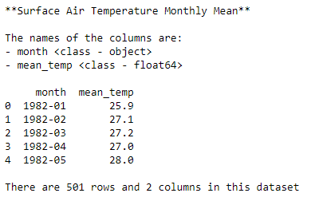
EDA on Mean Surface Temperature
- This dataset contains the monthly mean surface temperature in Singapore
- By placing this data in a line graph, we will be able to observe if there is any trend on the surface temperature and create an explanation.
Columns:
Month = months from 1982 onwards
Mean_temp = mean temperatures of each month

Slide 14
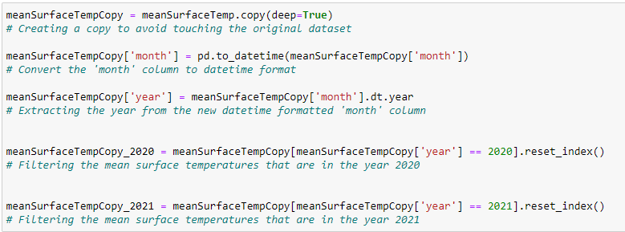
Data Manipulation on Mean Surface Temperature
Since my focus is more on the years 2020 and 2021, I will have to create new dataframes to store the data of both years.
After doing so, I will be able to plot 2 different line graphs (2020 and 2021) and place them in the same plot, and analyse the trends of the 2 line charts.

Slide 15
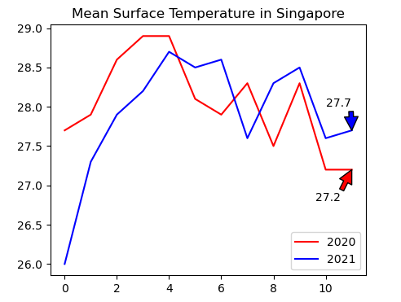
Line Chart on Mean Surface Temperature
Reason → I chose line chart as a line chart allows us to notice any trends present in the chosen data.
Even though 2020 starts out at a higher temperature compared to 2021, 2021 had a higher mean surface temperature most of the time from the 5th month onwards.
2021 ended at a higher mean surface temperature compared to 2020.
Overall, 2021 had an increase in its surface temperature which can be seen on the line graphs plot on the right.

Slide 16
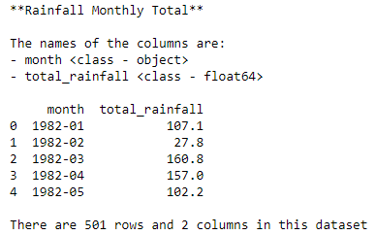
EDA on Rainfall - Monthly Total
- This dataset contains the total amount of rainfall per month
- By using this dataset, we can observe if the amount of rainfall changes if climate change (global warming) is more serious
Columns:
Month = months from 1982 onwards
Total_rainfall = amount of rainfall per month

Slide 17
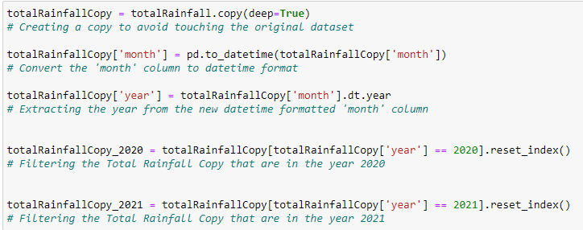
Data Manipulation on Rainfall - Monthly Total
Similar to the data manipulation on mean surface temperature, since my focus is more on the years 2020 and 2021, I will have to create new dataframes to store the data of both years.
After doing so, I will be able to plot 2 different boxplots for both years (2020 and 2021) and place them in the same plot to allow a side-by-side comparison.

Slide 18
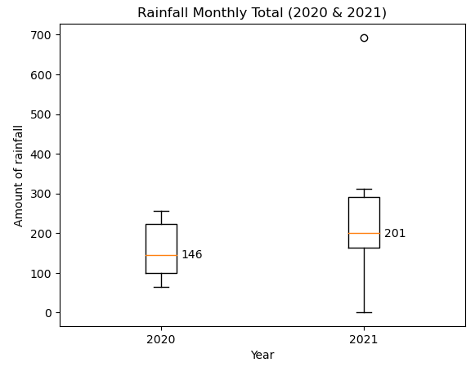
Boxplot on Rainfall – Monthly Total
Reason → I chose boxplot as a boxplot contains the median, ranges, interquartile range, even outliers if there is.
We can observe that:
2021 has a longer lower fence, suggesting that 2021 is negatively-skewed.
2021 has overall, more rainfall compared to 2020
The median in 2021 is larger compared to the median in 2020
Overall, it is seen that 2021 contains a higher amount of monthly total rainfall compared to 2020.

Slide 19
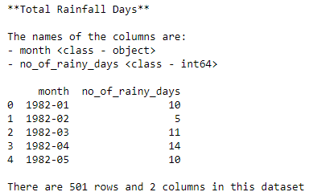
EDA on Rainfall - Monthly Number of Rain Days
- This dataset contains the total days of rainfall per month
- By using this dataset, we can observe if there is any increase or decrease to the number of rainfall days for both of the years
Columns:
Month = months from 1982 onwards
No_of_rainy_days = number of rainfall days per month

Slide 20
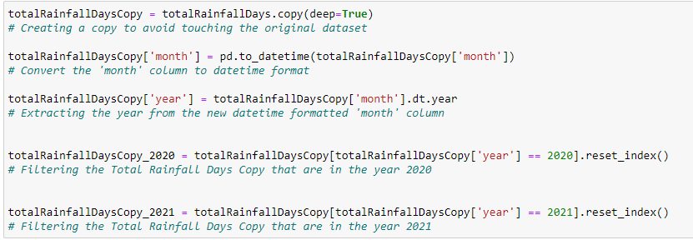
Data Manipulation on Rainfall - Monthly number of rain days
Similar to the data manipulation on mean surface temperature, since my focus is more on the years 2020 and 2021, I will have to create new dataframes to store the data of both years.
After doing so, I will be able to plot 2 different histograms for both years (2020 and 2021) and compare their distributions.

Slide 21
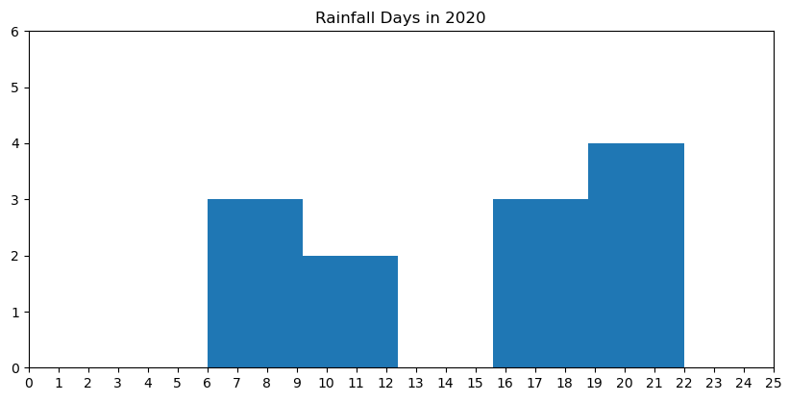
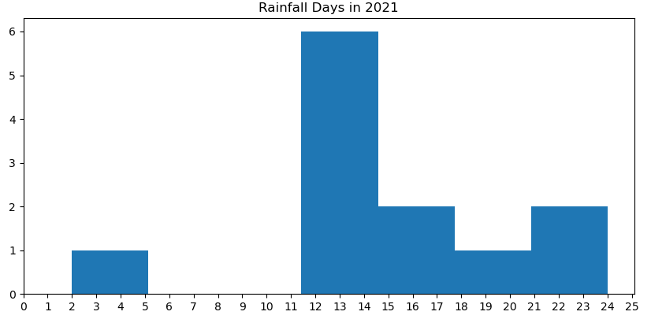
Scatter Plot on Rainfall - Monthly number of rain days
Reason → I chose scatter plot as I can display the relationship between two variables and observe the nature of the relationship.
From the scatter plots on the right, I can observe that:
The number of rainfall days in 2020 is spread out, while the number of rainfall days in 2021 has more bell-shaped curve with a distinct peak.
In 2021, there are more rainfall days compared to 2020.
Overall, we can observe that climate change (global warming) can results to more rainfall days in a month.

Slide 22
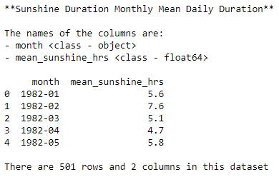
EDA on Sunshine Duration
- This dataset contains the sunshine duration of each month from 1982
- By using this dataset, we can observe if there is changes in the sunshine duration of the years 2020 and 2021.
Columns:
Month = months from 1982 onwards
mean_sunshine_hrs = number of hours of sunshine in Singapore

Slide 23
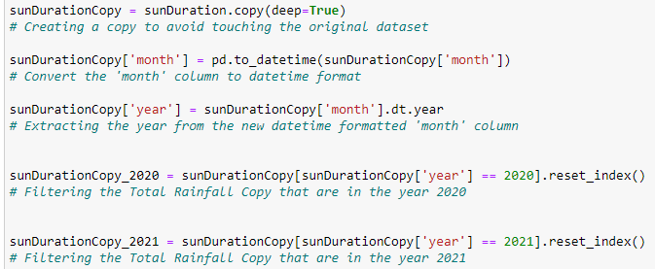
Data Manipulation on Sunshine Duration
Similar to the data manipulation on monthly rainfall days, since my focus is more on the years 2020 and 2021, I will have to create new dataframes to store the data of both years.
After doing so, I will be able to plot 2 different boxplots for both years (2020 and 2021) and compare their trends.

Slide 24
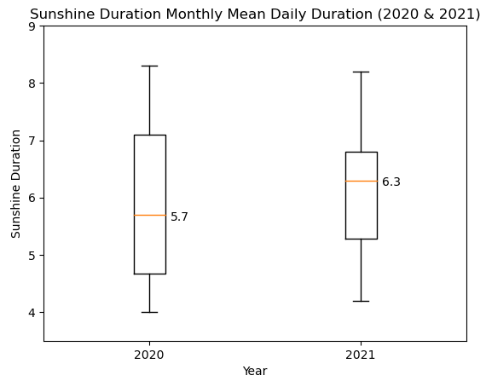
Line Chart on Sunshine Duration
Reason → I chose boxplot as a boxplot contains the median, ranges, interquartile range, even outliers if there is.
From the boxplot on the right, we can observe that:
Ranges of both boxplots are around the same
The median in 2021 is higher compared to the median in 2020.
The interquartile range in 2020 is larger compared to the interquartile range in 2021.
As a results of the plots, we can observe that 2021 has overall, a higher sunshine duration due to the higher median and smaller interquartile range.

Slide 25
Conclusion
Comparison of 2021 to 2020
2021 had an increase in surface temperature.
2021 had a higher monthly total amount of rainfall.
2021 had more months with more rain days.
2021 had a higher sunshine duration
2021 had a more serious global warming (climate change) compared to 2020.
To conclude, we can observe that climate change (global warming) mostly impacts Singapore by increasing the aspects of weather, such as temperature, amount of rain and number of rain days, and even sunshine duration.
These effects can be detrimental to many countries, not only Singapore. Therefore, many countries should take climate change more seriously and find solutions to prevent it from becoming worse before it gets to a point where nothing can be done to stop climate change (global warming

Slide 26
Reference Links:
Emissions by gas type - https://tablebuilder.singstat.gov.sg/table/TS/M891321
Surface Air Temperature - Monthly Mean - https://beta.data.gov.sg/collections/1419/view
Rainfall - Monthly Total - https://beta.data.gov.sg/collections/1399/view
Sunshine Duration- Monthly Mean Daily Duration - https://beta.data.gov.sg/collections/1417/view
Rainfall - Monthly Number of Rain Days - https://beta.data.gov.sg/collections/1398/view

